Slide 1
Study Time Calculator
Hadassa Franklin (VC1A) – Dassiefranklin@gmail.com
Evie Barth (VC1B) - eviebarth18@gmail.com
Supervisor - Professor Katherine Chuang - chuang@sci.brooklyn.cuny.edu

Slide 2
Abstract
The goal of the Study Time Calculator is to help students calculate the amount of time they need to set aside for schoolwork and devise a weekly study schedule, enabling them to allocate their time wisely throughout the week and complete all their coursework. Students will input their classes hours, work hours and other relevant data such as extracurricular activities that they have upcoming. The program will then advise them on how much time they should have to allocate for schoolwork per week and assist them in finding suitable time slots in their schedules to complete it. This goal of this project aims to facilitate students in completing their coursework each week and discourage students from leaving everything until the last minute. The program outputs this data in a weekly schedule format, which we hope to integrate with Google Calendar for convenient use. The target users are Brooklyn College students. While the basic features can cater to any student, we hope to incorporate additional features specific to Brooklyn College, such as a map of study spaces and their operating hours.

Slide 3
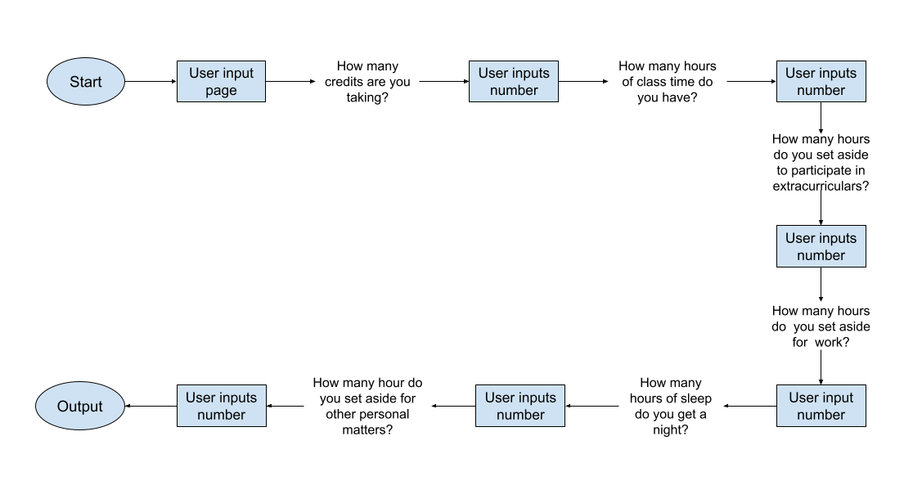
User Flow
Originally, we had planned on having a login page and to have trackers, so this page was more intricate. Also, we had made certain questions yes or no and based on your response you might have been asked additional questions, e.g., You would be asked if you worked. If you answered yes, you would then be asked how many hours. The user would also have been able to schedule study time on a calendar connected to Google Calendar based on the resulted output.

Slide 4
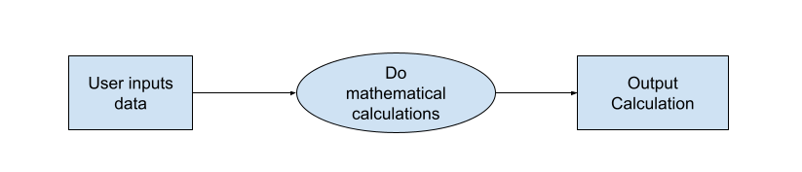
Data Flow Diagram of Application Logic
The user will input data as integers or doubles. These will be used for the calculations which will calculate the amount of time already allocated for activities and will output the remaining time they have to allocate towards schoolwork.
Originally, we were going to store the data and then do calculations based on the stored data. We were going to have trackers as well.

Slide 5
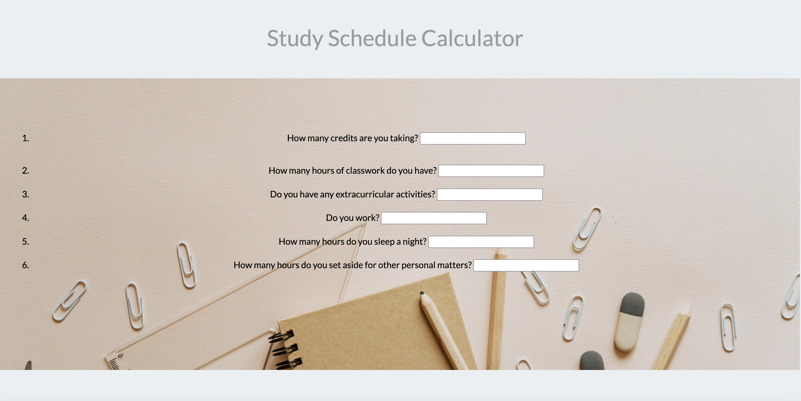
Initial User Interface

Slide 6
Tentative Schedule
Task | 1 | 2 | 3 | 4 | 5 | 6 | 7 | 8 | 9 | 10 | 11 | 12
Project planning, design, and logic
Make up paperwork (started project late)
Proof of concept
Write code for front end and user interface and test it
Write code for back end/database and test it
Connect to google calendar
Work on final presentation and slides
Work on other course requirements

Slide 7
Use Cases
A freshman student wants to test out possible schedule options and see how the different ones will work with their other obligations and if they will be able to manage their course load. The user must input the necessary data for each variation, and they will receive the different calculations. This can help them figure out what schedule and how large a courseload they can manage.
A student who works a job or has an internship wants to ensure that they will have enough time to complete all their schoolwork for that week. The user inputs the necessary data, and the system will output if they have enough hours in their week. If not, the program will give them an error, informing them that they do not have enough time in their week to accomplish everything they want to, and they will have to re-prioritize.
A senior wants to see if they have the bandwidth to add an independent project/thesis to their schedule on top of their obligations and other classes, if it requires 15 hours a week of work. The user inputs the necessary data, and the system will output if they have enough hours in their week. If not, the program will give them an error message and they will either have to rearrange their schedule or take it a different semester.

